Slide 1
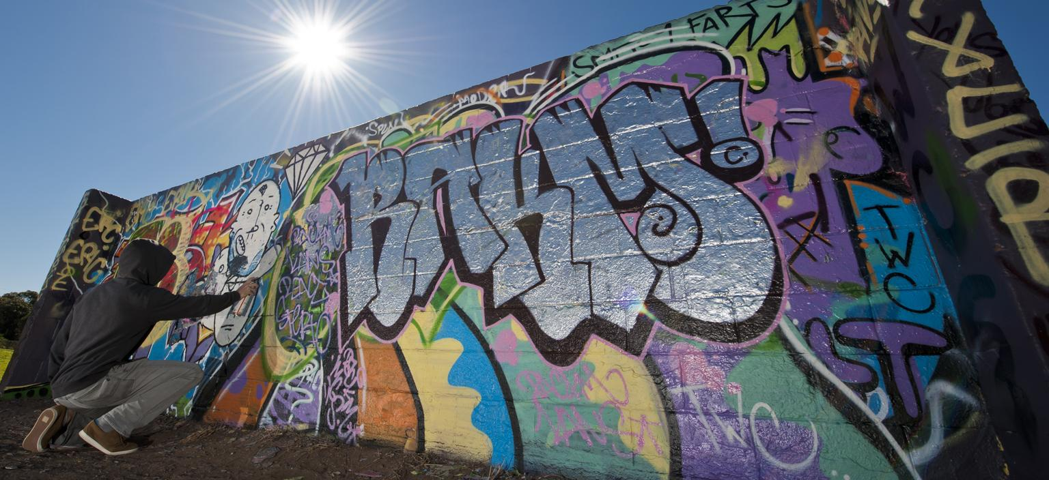
Graffiti Incident Tracking System
(GITS)
Lessons Learned & Test Report
Team: Michael Jannain, Julian Nunez, Jose Garcia, Jimmy Doan

Slide 2
Comparison of Project Plans & Actual Performance
Stayed on track with the planned schedule for the most part.
Completed nearly all of the requirements for GITS.
Worked well as a team.
We assigned roles in the beginning of the process but because of our small group size, we all contributed to whatever area needed attention.

Slide 3
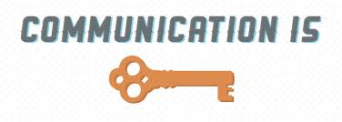
Lessons Learned
Communication is key.
Constant communication to track group/individual progress, schedule group meetings, and assign jobs to every team member.
Text Messages, Emails, Google Hangouts & Shared Documents.
Time Management is a tool and skill.
We managed our time better as we got further along in the process.
Planned ahead and divided work up over longer periods of time to decrease scrambling and stress.

Slide 4
Self Assessment
Great team work.
Everyone contributed their fair share & was willing to contribute outside their “role” areas.
Accomplished nearly all requirements and everything we set out to do.
Stayed on schedule and according to plan for the most part.
No major delays or setbacks.
Overall, we are proud and satisfied with our work and the manner in which we completed it.

Slide 5
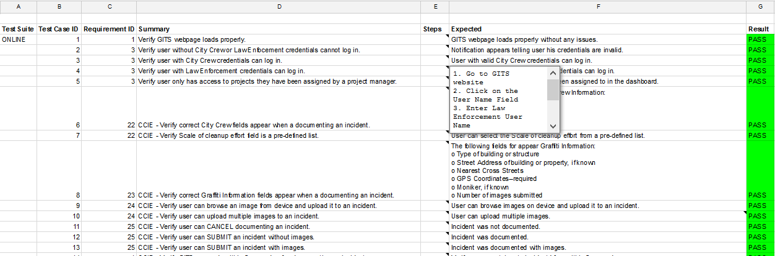
Test Suite
Snippet of the Test Suite with Results (Pass/Fail):

Slide 6
Uncompleted GITS Requirement
Online Help Function wasn’t implemented due to time constraints.

